Slide 1
Melbourne Relocation Assistance tool
Christopher van de vyver

Slide 2
OUTLINE
The Problem
Data Required
Data Handling
Methodology
Visualization Tool
Ranked Local Government Area Dataframe
Conclusions
Recommendations

Slide 3
The greatest decision individuals relocating to any new city are faced with, is choosing a place to stay. This decision impacts your family and social life, transport time to work as well as rental costs.
The main contributing factors when deciding on a location to stay is the rental cost, safety of the area, proximity to public transport and grocery stores/supermarkets.
The problem

Slide 4



Data required
- Foursquare LGA location data
- Crime statistics for the various LGAs
- Median rental rates for the specific LGAs
Methods such as web scraping will be used in order to obtain the information from the various related websites.
STATISTICS.VIC.GOV
DHHS.VIC.GOV

Slide 5
Data handling
Data will be obtained from relevant sources using different methods such as APIs and web scraping.
Data needs to be converted from source to usable format that can be imported into Notebook.
Import data into Notebook for modelling.

Slide 6
Methodology
Foursquare Query
Queries were run for the terms “Bus Stops”, “Train Stations” and “Grocery Stores” using the Foursquare API
Rental and crime data were obtained from Statistics Australia.
Data Handling
Data handling methods were used to convert the data into the usable forms.
Crime and Rental Statistics
Visualization
Ranked Dataframes
Python package Folium was used to create map visualization tool.
Ranked dataframes were created to display the best scoring LGAs according to crime and rental statistics.

Slide 7
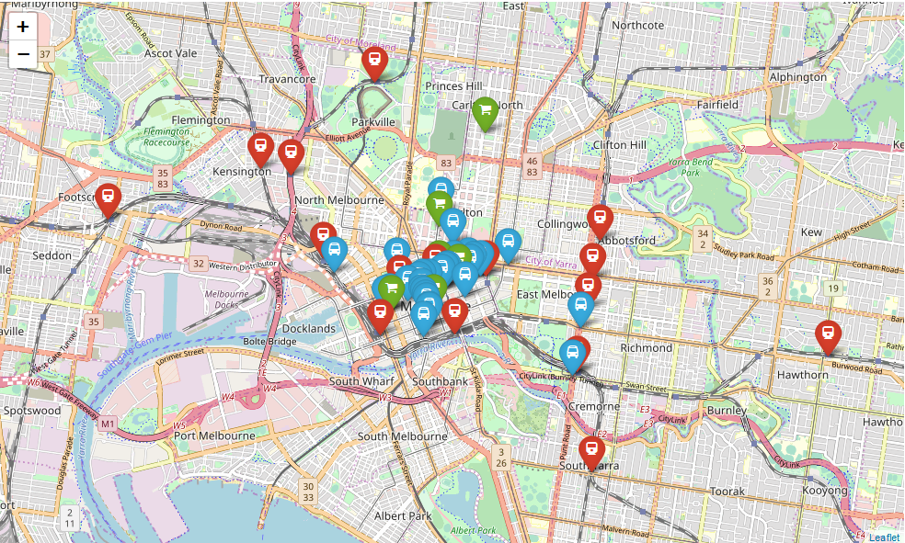
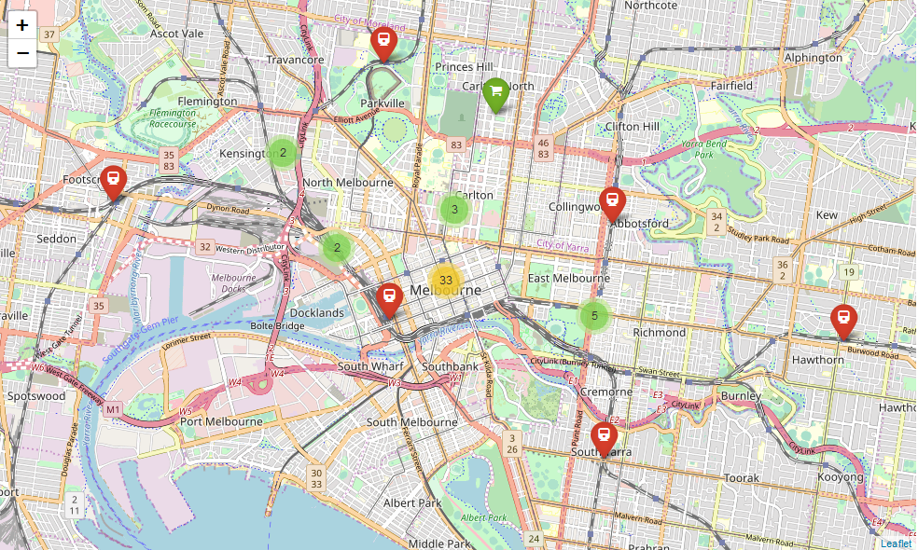
Visualization tOOL
The venues were clustered to allow the map to not be so densely clustered and allow easier interpretation.
Before after

Slide 8
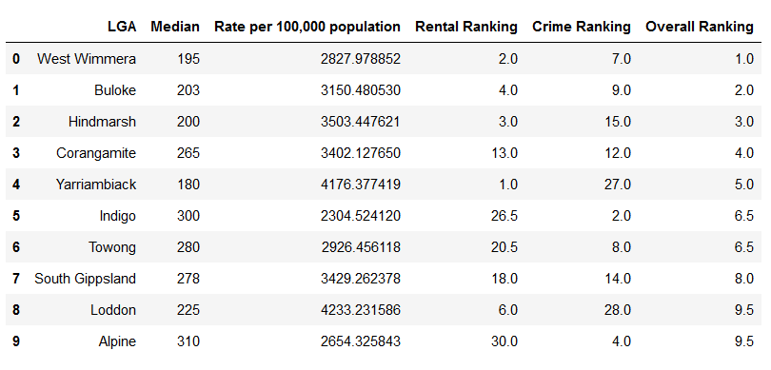
Ranked Local government area dataframe
A final dataframe comprising of all the Local Government Areas was created whereby the LGAs were ranked according to their median rental rate and crime incident rate.

Slide 9
Conclusions
The best scoring LGAs may not necessarily be most optimal LGA for the individual’s requirements.
Even though the best scoring LGAs may not suit the user’s criteria, the tool is still extremely useful and will yield benefits to the user by allowing them to select the most optimal LGA.
The visualisation is an effective tool to be used in conjunction with the ranking system dataframes. One should not be used without the other.

Slide 10
Recommendations
Additional venues may be added to increase the comprehensiveness of the mapping tool and enable users to make a more informed decision.
More statistics such as number of restaurants or hospitals can be included in venue search. Even schools for couples or families moving.

